Slide 1

House Prices in Cincinnati
Data Analytics Project
Presented By:
Aruna Harini Yandrapally

Slide 2
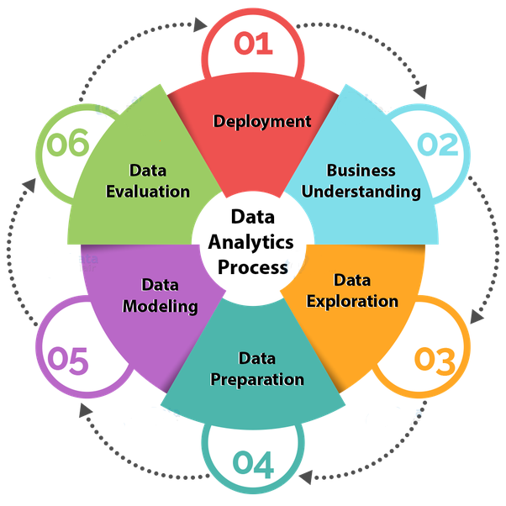
Objective: To build a model using historic data to predict the selling prices of houses in Cincinnati
Steps involved in Data Analysis

Slide 3
Data Collection, Cleaning & Visualization
Dataset has 18 covariates including Zipcode, Bedrooms, Bathrooms, SquaredfeetArea, Yearbuilt etc. and 389 records collected manually from various websites.
Lot of data entry & duplication issues present in the collected data, Hence data cleaning was mandatory. All such problematic records were deleted as part of Data cleaning process.
Added a new variable ‘Age’ computed from Built in year.
Visualized the data using 3d figures, pairs.panels() and boxplot() to study about the outliers, skewness, correlation, etc.

Slide 4
Data Modeling
Model Adequacy Checking - Transformations - Variable Selection - Model Validation - Final Model obtained for both datasets.
Built two models - First with the data set which contains the basic variables such as Zipcode, bathrooms, bedrooms, SquaredfeetArea, Age etc.
The second model uses the data set which has more information/variables such as Parking Spaces, basement, Stories , Fireplace, etc.
model_final<-lm(log(Soldprice)~bathrooms+Squaredfeet+as.factor(zipcode)+Fireplace)
model_final1<-lm(log(Soldprice)~as.factor(Zipcode)+bathrooms+Squaredfeet+I(Age^2))

Slide 5
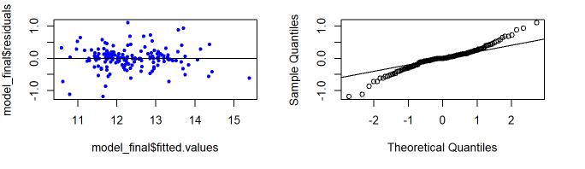
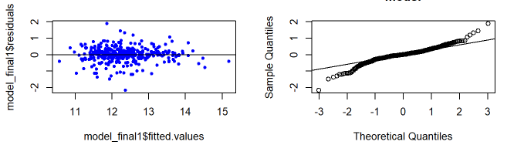
Model Adequacy
## Multiple R-squared: 0.8603, Adjusted R-squared: 0.8217
## Multiple R-squared: 0.7178, Adjusted R-squared: 0.6786
Model 1
Model 2

Slide 6
Model Validation – Prediction results for new test data
15 Data points collected manually from websites Zillow and Trulia
Next predictions are made using both models.
Comparison:
Model_1 | Model_2
MSPE: 0.0612 | MSPE: 0.0395
PRESS:0.73 | PRESS:0.63
Pred_R2:0.811 | Pred_R2:0.85
Actual_R2: 0.86 | Act_R2: 0.71

Slide 7
Model 1
Log(Soldprice)= 11.441274 + 0.893723 * as.factor(Zipcode)45202 + 0.219113 * as.factor(Zipcode)45203 + -0.523543 * as.factor(Zipcode)45205 + 0.52561 * as.factor(Zipcode)45206 + 0.465351 * as.factor(Zipcode)45207 + 0.820975 * as.factor(Zipcode)45208 + 0.752138 * as.factor(Zipcode)45209 + -0.187701 * as.factor(Zipcode)45211 + 0.248165 * as.factor(Zipcode)45212 + 0.488693 * as.factor(Zipcode)45213 + 0.400738 * as.factor(Zipcode)45214 + 0.440458 * as.factor(Zipcode)45215 + 0.206646 * as.factor(Zipcode)45216 + -0.370833 * as.factor(Zipcode)45217 + 0.083154 * as.factor(Zipcode)45218 + 0.110166 * as.factor(Zipcode)45219 + 0.620266 * as.factor(Zipcode)45220 + -0.134635 * as.factor(Zipcode)45223 + -0.269569 * as.factor(Zipcode)45224 + -1.026823 * as.factor(Zipcode)45225 + 0.605946 * as.factor(Zipcode)45226 + 0.365037 * as.factor(Zipcode)45227 + 0.032194 * as.factor(Zipcode)45229 + 0.023443 * as.factor(Zipcode)45230 + -0.22711 * as.factor(Zipcode)45231 + 0.826262 * as.factor(Zipcode)45232 + -0.084082 * as.factor(Zipcode)45233 + 0.283973 * as.factor(Zipcode)45236 + -0.736494 * as.factor(Zipcode)45237 + -0.398909 * as.factor(Zipcode)45238 + -0.253899 * as.factor(Zipcode)45239 + 0.009879 * as.factor(Zipcode)45240 + -0.018657 * as.factor(Zipcode)45241 + 0.089259 * as.factor(Zipcode)45242 + 0.845583 * as.factor(Zipcode)45243 + 0.089665 * as.factor(Zipcode)45244 + 0.070775 * as.factor(Zipcode)45245 + -0.219987 * as.factor(Zipcode)45246 + 0.499129 * as.factor(Zipcode)45247 + 0.28744 * as.factor(Zipcode)45248 + 0.530826 * as.factor(Zipcode)45249 + -0.208452 * as.factor(Zipcode)45251 + 0.157024 * as.factor(Zipcode)45255 + -0.113609 * as.factor(Zipcode)45320 + 0.122588 * bathrooms + 0.000264 * Squaredfeet + -2.2e-05 * I(Age^2)
Model 2
Log(Soldprice)= 11.619077 + -0.890187 * as.factor(zipcode)45204 + -1.591883 * as.factor(zipcode)45205 + -0.511731 * as.factor(zipcode)45206 + 0.058641 * as.factor(zipcode)45208 + 0.092693 * as.factor(zipcode)45209 + -0.882445 * as.factor(zipcode)45211 + -0.840574 * as.factor(zipcode)45212 + -0.116983 * as.factor(zipcode)45213 + -0.350411 * as.factor(zipcode)45214 + -0.054951 * as.factor(zipcode)45215 + -1.746555 * as.factor(zipcode)45216 + -0.560916 * as.factor(zipcode)45217 + -0.856847 * as.factor(zipcode)45220 + -0.468655 * as.factor(zipcode)45223 + -0.771522 * as.factor(zipcode)45224 + -1.586834 * as.factor(zipcode)45225 + -0.11656 * as.factor(zipcode)45226 + -0.56927 * as.factor(zipcode)45227 + -0.651412 * as.factor(zipcode)45230 + -0.679679 * as.factor(zipcode)45231 + -0.635661 * as.factor(zipcode)45233 + -0.977077 * as.factor(zipcode)45237 + -1.018057 * as.factor(zipcode)45238 + -0.757273 * as.factor(zipcode)45239 + -1.00521 * as.factor(zipcode)45240 + -0.106596 * as.factor(zipcode)45243 + -0.365949 * as.factor(zipcode)45244 + -0.523933 * as.factor(zipcode)45245 + -0.260313 * as.factor(zipcode)45248 + -0.43716 * as.factor(zipcode)45249 + -0.4951 * as.factor(zipcode)45255 + 0.000317 * Squaredfeet + 0.173776 * bathrooms + 0.216597 * Fireplace
Final Model

Slide 8

Prediction
Calculate the Sum of squared prediction errors for this model

